Slide 1
Matthew 7:1-14 (ESV)
1“Judge not, that you be not judged. 2For with the judgment you pronounce you will be judged, and with the measure you use it will be measured to you. 3Why do you see the speck that is in your brother’s eye, but do not notice the log that is in your own eye? 4Or how can you say to your brother, ‘Let me take the speck out of your eye,’ when there is the log in your own eye? 5You hypocrite, first take the log out of your own eye, and then you will see clearly to take the speck out of your brother’s eye.

Slide 2
Matthew 7:1-14 (ESV)
6 “Do not give dogs what is holy, and do not throw your pearls before pigs, lest they trample them underfoot and turn to attack you.
7 “Ask, and it will be given to you; seek, and you will find; knock, and it will be opened to you. 8For everyone who asks receives, and the one who seeks finds, and to the one who knocks it will be opened. 9Or which one of you, if his son asks him for bread, will give him a stone? 10Or if he asks for a fish, will give him a serpent?

Slide 3
Matthew 7:1-14 (ESV)
11If you then, who are evil, know how to give good gifts to your children, how much more will your Father who is in heaven give good things to those who ask him!
12 “So whatever you wish that others would do to you, do also to them, for this is the Law and the Prophets.
13“Enter by the narrow gate. For the gate is wide and the way is easy that leads to destruction, and those who enter by it are many. 14For the gate is narrow and the way is hard that leads to life, and those who find it are few.

Slide 4
The King's Manifesto
Matthew 5 to 7

Slide 5
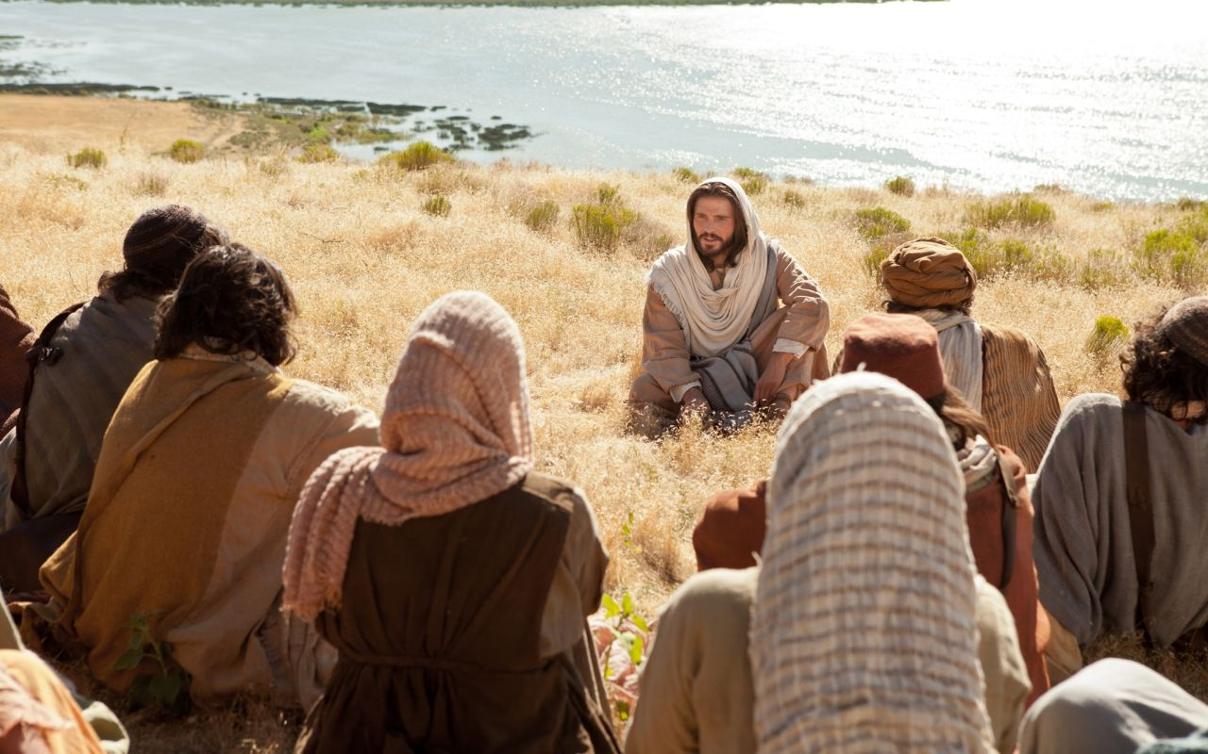
TODAY:
A New Divide
Matthew 7

Slide 6
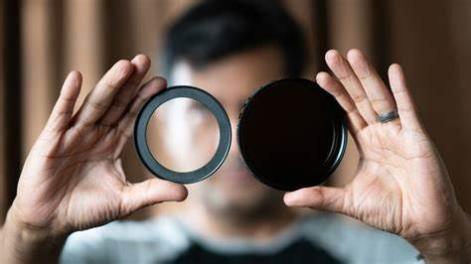
1. Two types of filters (vs. 1-12)

Slide 7
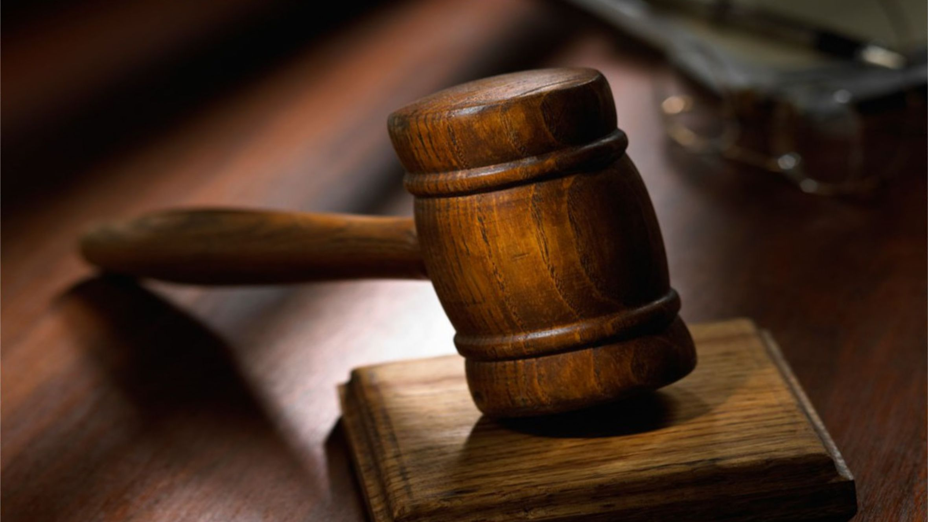
Responding to others with a condemning spirit
“Judge not, that you be not judged.
In the same way you judge others, you will be judged…”
(vs. 1-2)

Slide 8
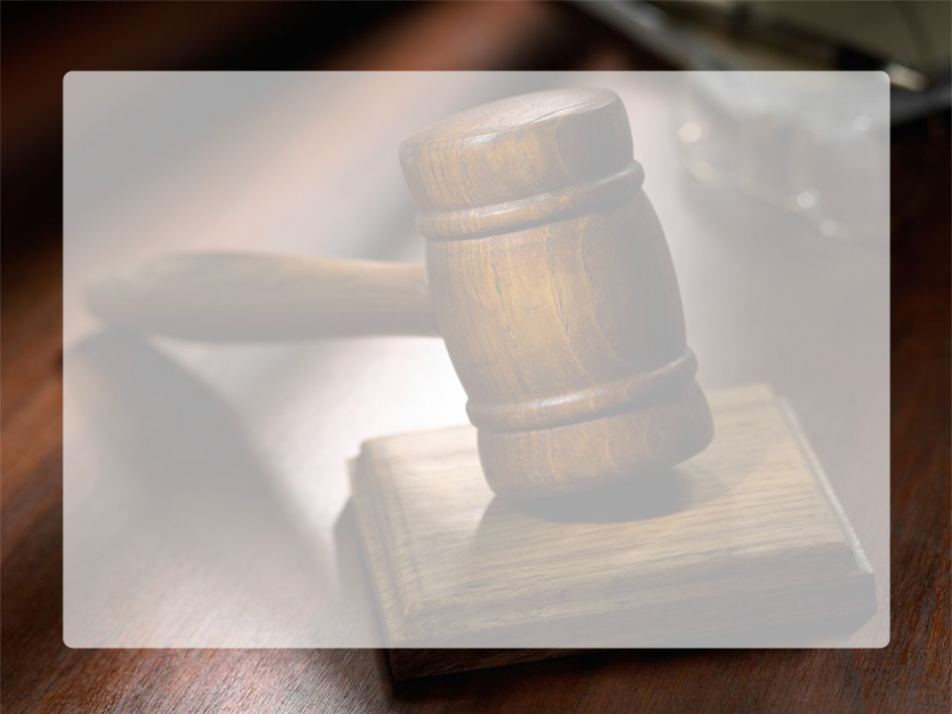
God-made rules
Condemning judgment
Superficial judgment
Hypocritical judgment
"they preach, but do not practice. They tie up heavy burdens, hard to bear, and lay them on people’s shoulders, but they themselves are not willing to move them with their finger“ (Matt 23:3-5)
Harsh, unforgiving judgment
Self-righteous judgment
Untrue judgment

Slide 9
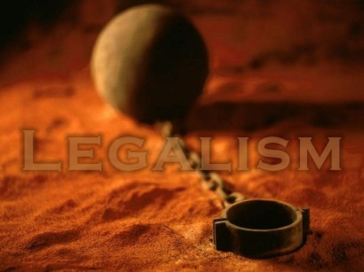
Man-made rules
What is legalism?
Legalism is the religion of seeking God’s approval and blessing by the keeping of man-made rules
“… How foolish can you be? After starting your Christian lives in the Spirit, why are you now trying to become perfect by your own human effort?” Gal. 3:3

Slide 10
"Therefore do not let anyone judge you by what you eat or drink, or with regard to a religious festival, a New Moon celebration or a Sabbath day. These are a shadow of the things that were to come; the reality, however, is found in Christ ... Since you died with Christ to the basic principles of this world, why do you submit to its rules…”?
(Col 2:16-21)

Slide 11
Responding to others with discernment
“ Stop judging by mere appearances, but instead judge correctly”
(John 7:24)

Slide 12
Responding to others with grace
We need a grace filter!
“So (therefore) whatever you wish that others would do to you, do also to them, for this is the law and the prophets“ (v.12)

Slide 13
2. Two types of fruit (vs. 13-20)

Slide 14
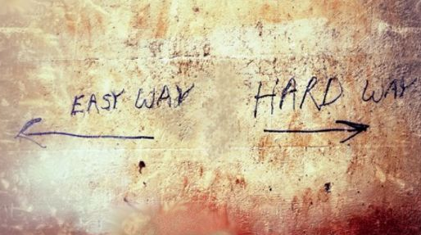
The way to choose
"Enter by the narrow gate. For the gate is wide and the way is easy that leads to destruction, and those who enter by it are many. For the gate is narrow and the way is hard that leads to life, and those who find it are few“ (v.13-14)

Slide 15
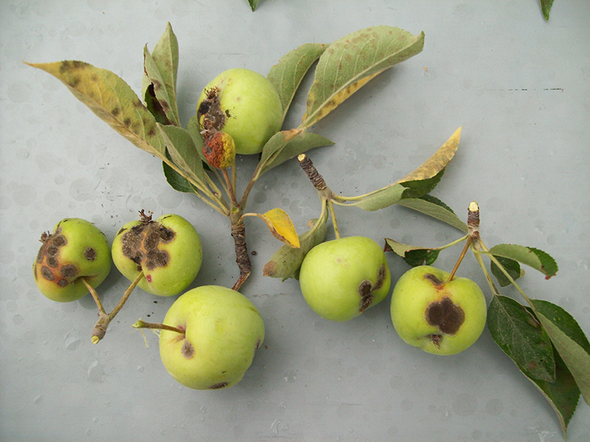
The warning to heed
“Beware of false prophets, who come to you in sheep's clothing but inwardly are ravenous wolves... You will recognize them by their fruits" (v.15-20)

Slide 16
3. Two types of faith (v. 21-27)

Slide 17
Those with a false confidence
“Not everyone who says to me, 'Lord, Lord,' will enter the kingdom of heaven, but the one who does the will of my Father who is in heaven … And then will I declare to them: I never knew you; depart from me, you workers of lawlessness”
(vs. 21,23)

Slide 18
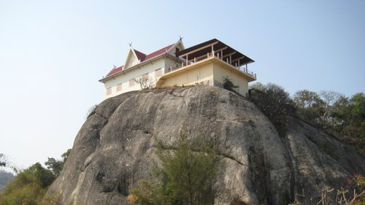
Those with a firm foundation
“Everyone then who hears these words of mine and does them will be like a wise man who built his house on the rock. … it did not fall, because it had been founded on the rock” (v.24-25)

Slide 19
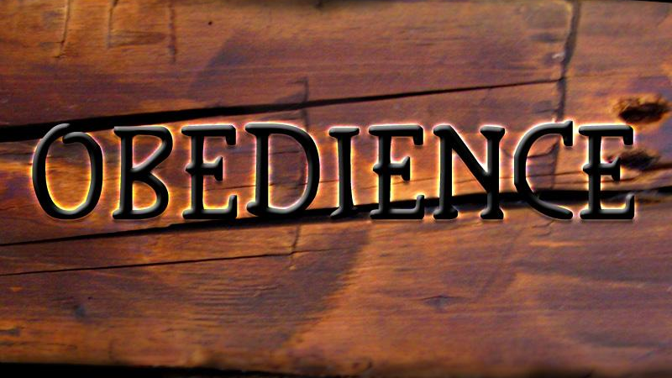
Saving faith is not conditional on obedience, but evidenced by obedience

